Slide 2
Halo Wars : The Terrain Of Next Gen
Colt McAnlis
BONFIRE Studios
SMU GuildHall
Microsoft Ensemble Studios
1 Hour

Slide 3
How It Started
New 360 specific engine in 2006
Focus on new visuals to distinguish title
Focus on hardware advantages / performance
Focus on advancements to the genre

Slide 4
Why New Terrain?
Occupies 70%-98% of RTS screen
Thus will see biggest bang for the buck
Issues with ‘cliff’ system in AOE3
Needed a different content gen process
Unique, hand crafted maps
Every map required personal touch
Not available in prior engine / tools

Slide 5
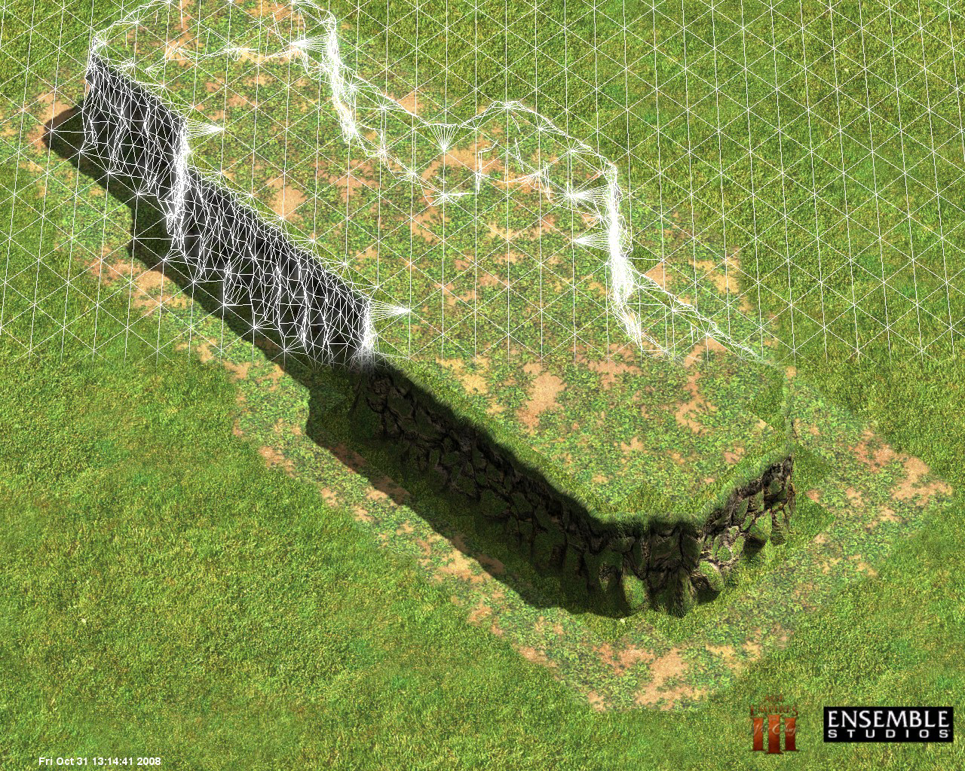

Slide 6
New Terrain Specs
Remove Cliff pieces
Awkward in authoring and memory footprint
Increase overall terrain to 8x resolution
Matches terrain cliffs resolution
Allow full vector-field displacement (XYZ)
Overhangs / vertical faces w/o needing the cliff system

Slide 8
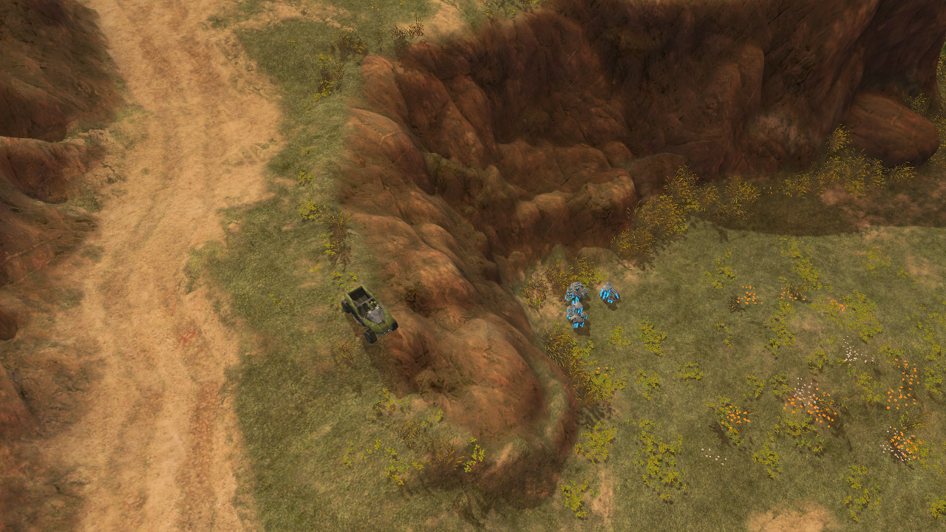

Slide 9
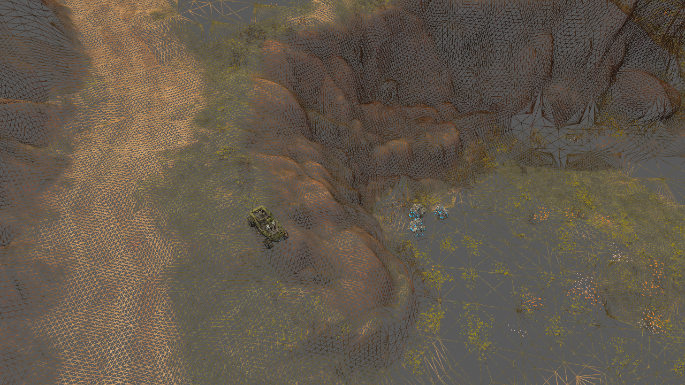

Slide 10
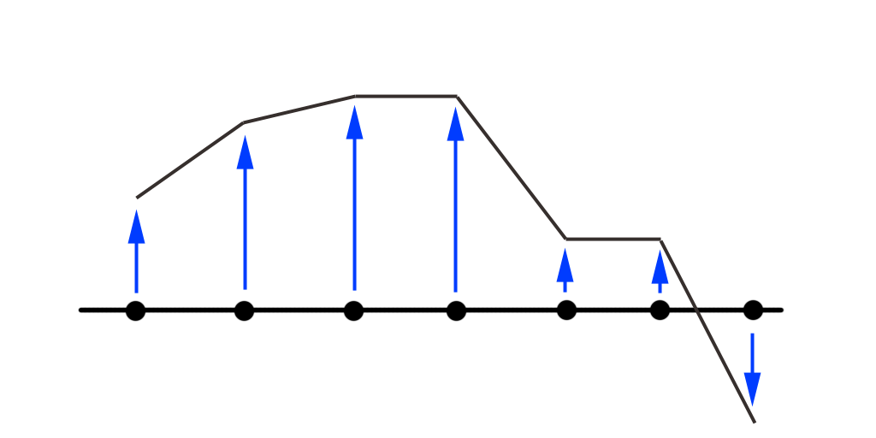
Height Field Setup

Slide 11
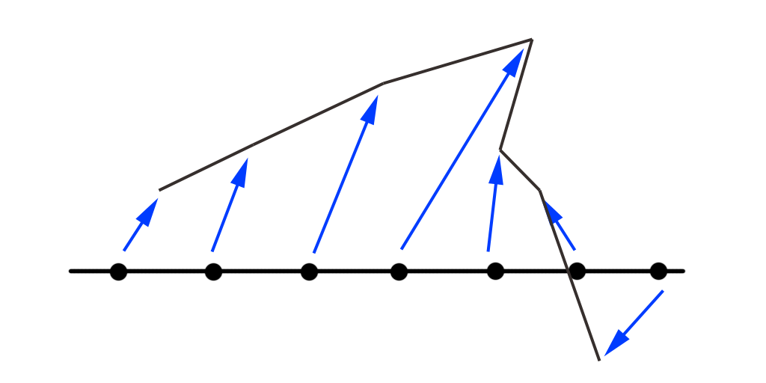
Vector Field Setup

Slide 12
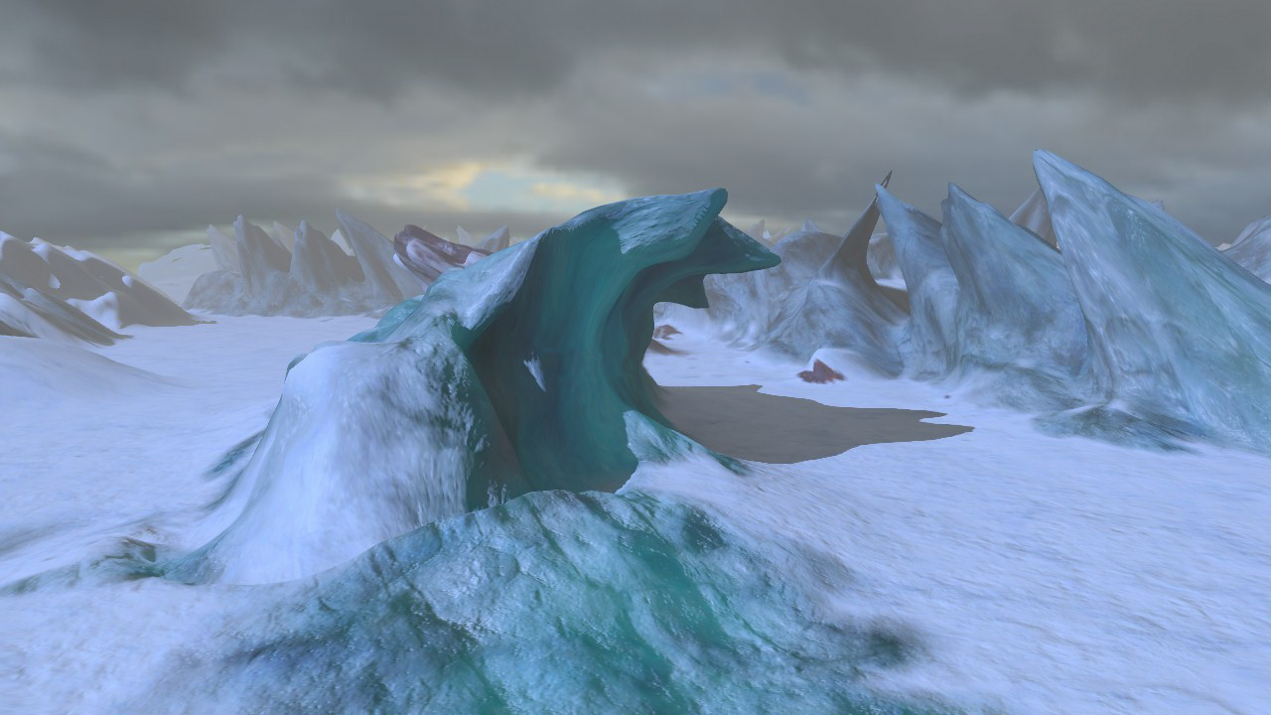

Slide 13
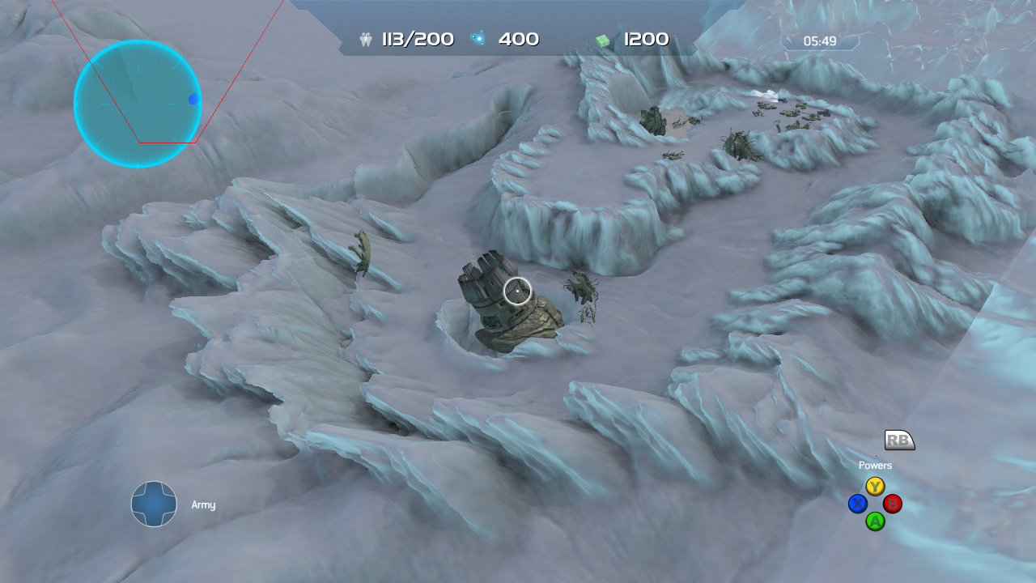

Slide 14
Mo’ Money = Mo’ Problems
Density increase was a huge win.
Introduced some new problems
Memory increase
Performance issues
Runtime texturing issues
Content creation burden
If we have time today!

Slide 15
Problem - Memory
Original terrain was 4k x 4k vertices
400mb of uncompressed data
200mb position, 200mb normals
But ONLY 512mb on the box!!
really only 480 that we have access too…
Compression to the rescue

Slide 16
Compression : Round 1
Reduced 400mb to 32mb!! (w00t!)
Combination of wavelets and DXT
Removed un-used / low frequency information
Decompressed on the GPU
Not fast enough
Too much data separation
7 textures housed all the data, Vertex texture fetch

Slide 17
Compression-ish?
Non-technical decisions reduced poly count
#1 Increased tile spacing and reduced count
Set the max terrain density @ 2k x 2k
#2 World space size ‘too large’
Set largest map size to 1280 x 1280 verts
Changed target memory footprint!

Slide 18
Compression : Round 2
Result : 14.063mb for 1280 x 1280 terrain.
XYZ, Normal get their own 11,11,10 textures
AO, ALPHA get their own DXT5A textures
Runtime ALPHA stored in DXT3A
1bit-per-vertex, separated in the shader.

Slide 19
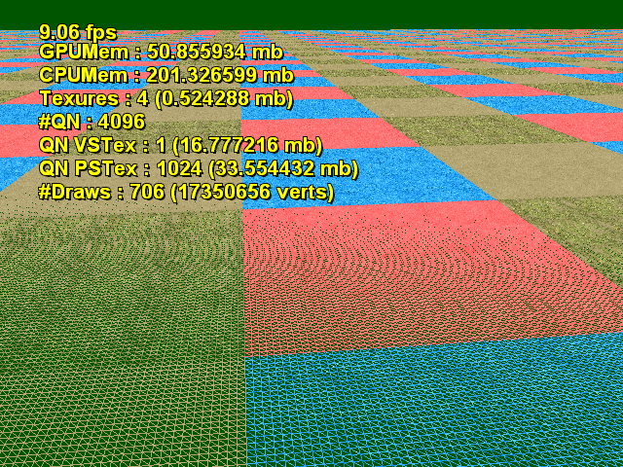

Slide 20
Target Problems
Introduced some new problems
Memory increase
Performance issues
Runtime texturing issues

Slide 21
Problem - LOD
Design doc change suddenly required FPS camera angle support
Density too high for these angles!
Needed a solution with specific criteria
Minimal Memory Footprint required

Slide 22
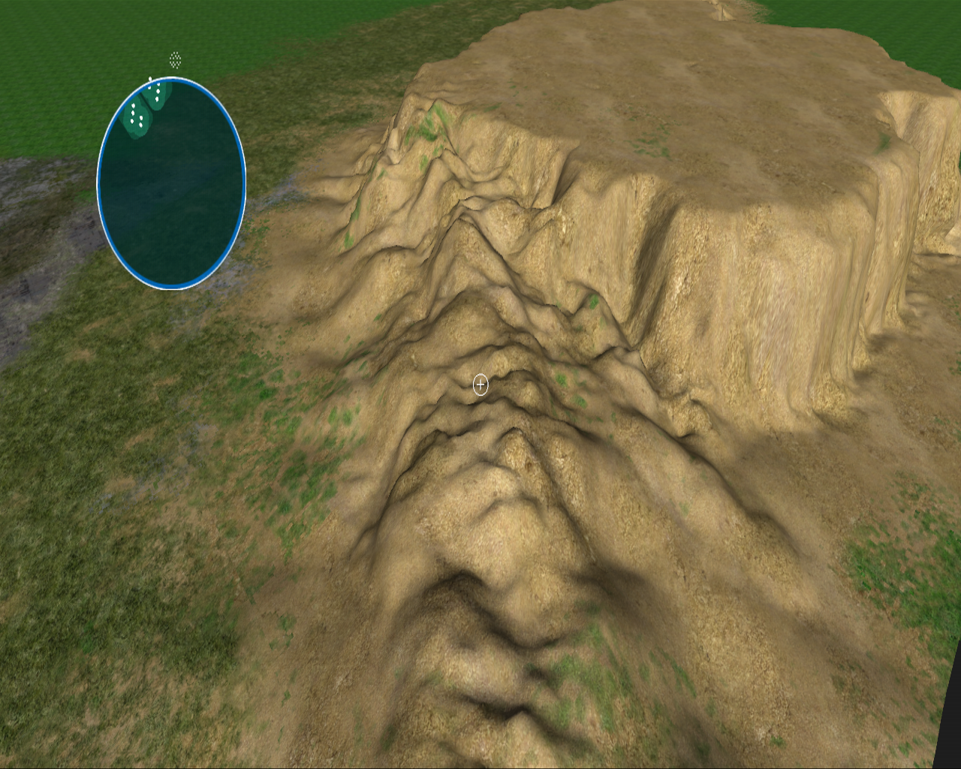
LOD Round 1 : GeoMipMap

Slide 23
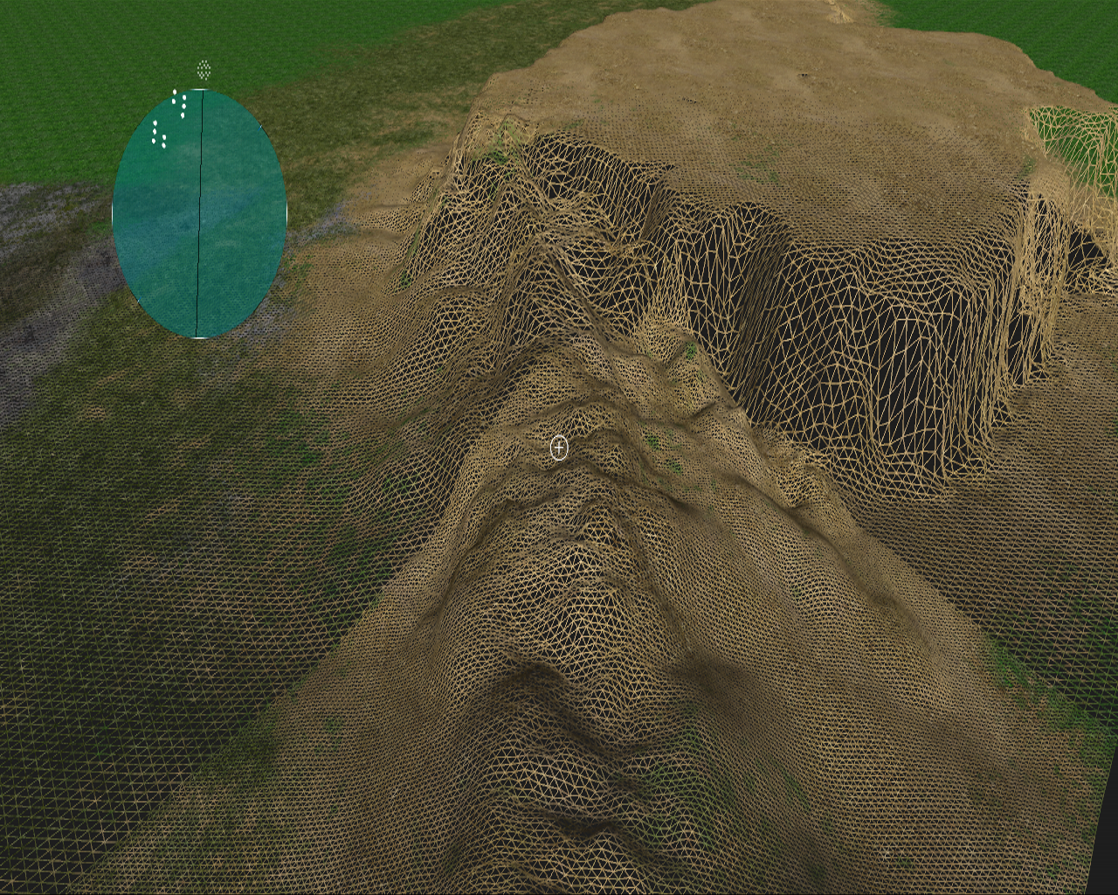

Slide 24
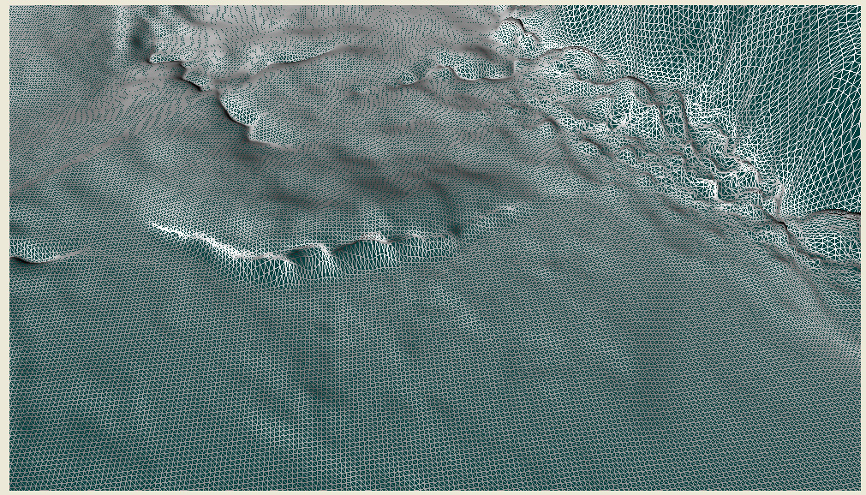
LOD Round 2 : RQT

Slide 25
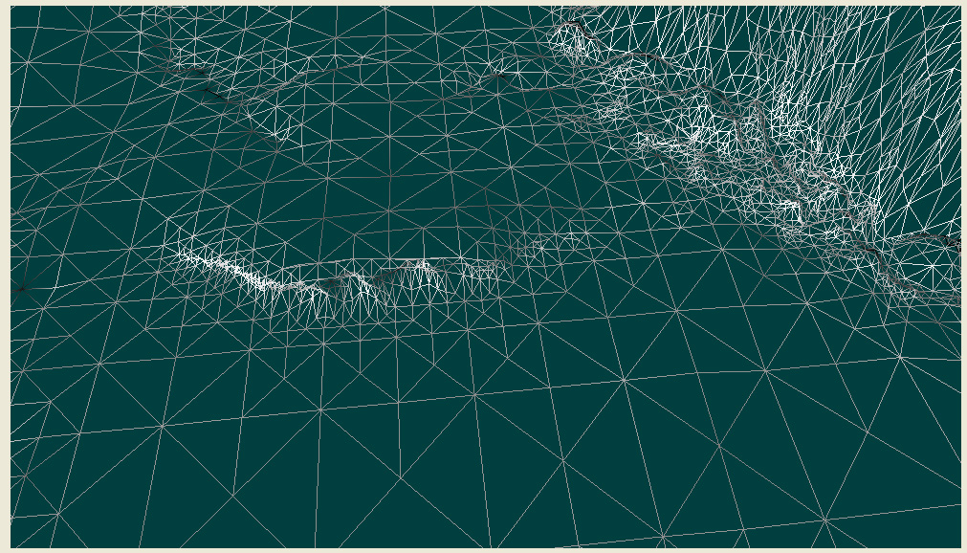

Slide 26
LOD Round 3: Hardware
Use hardware quad patch tessellation
Subdivide terrain to 16x16 patches
Project the patch into screen-space @ runtime
Determine visible contribution in screen area
Interpolate between set tessellation steps

Slide 27
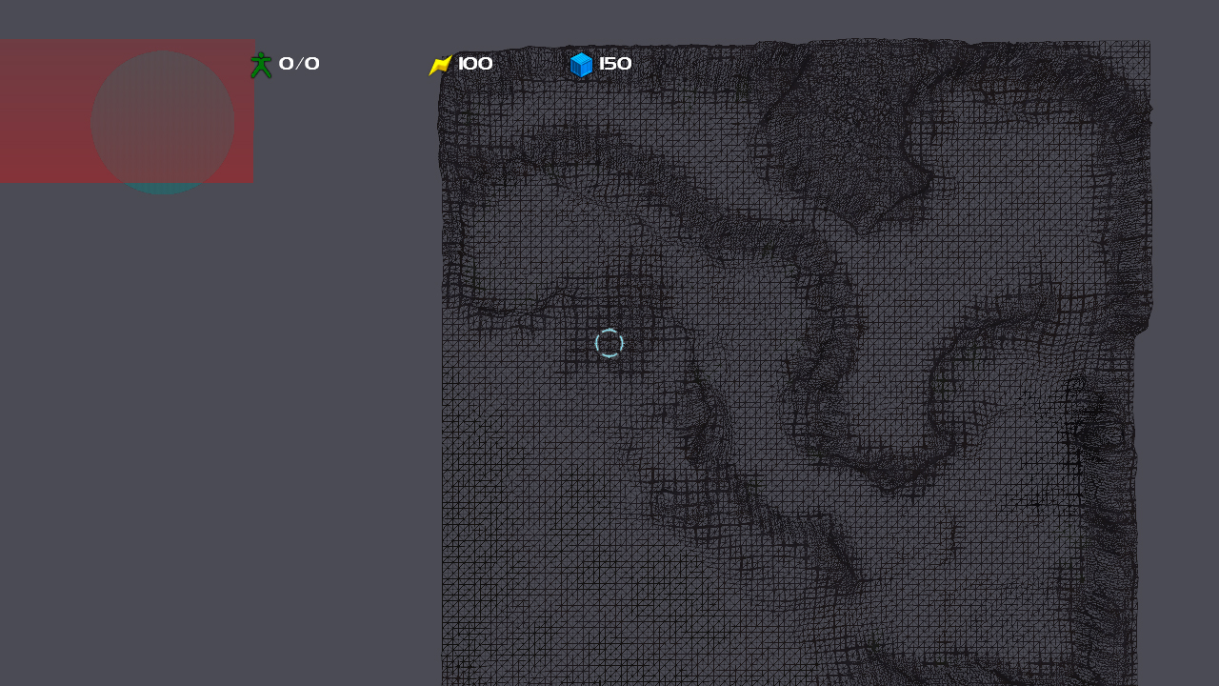

Slide 28
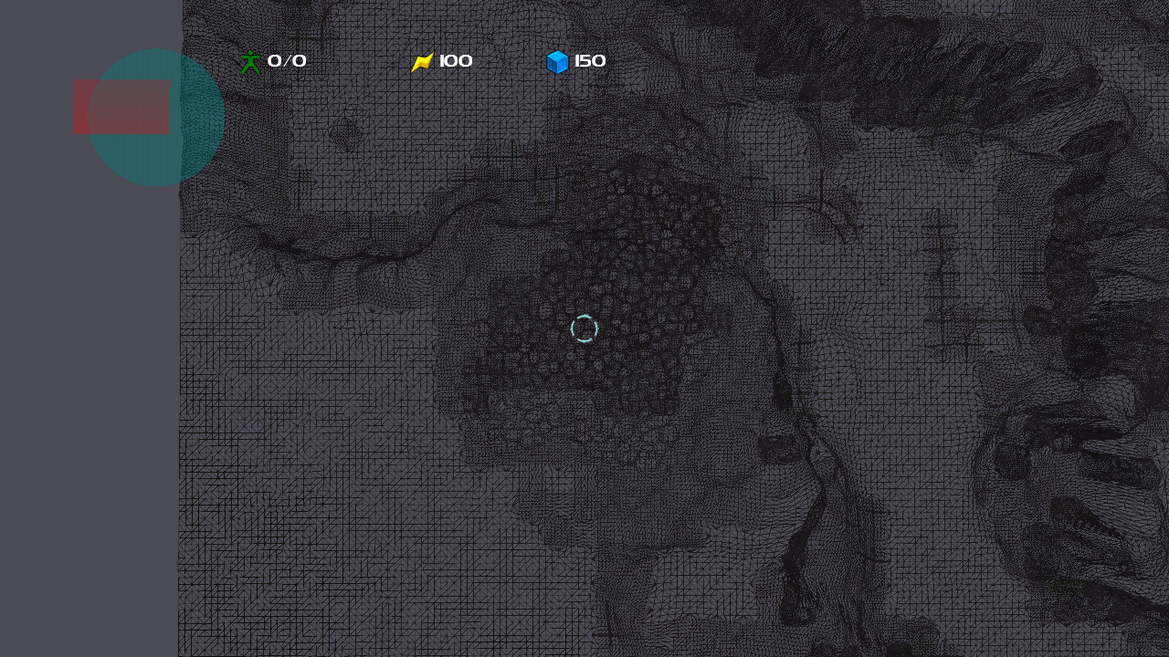

Slide 29
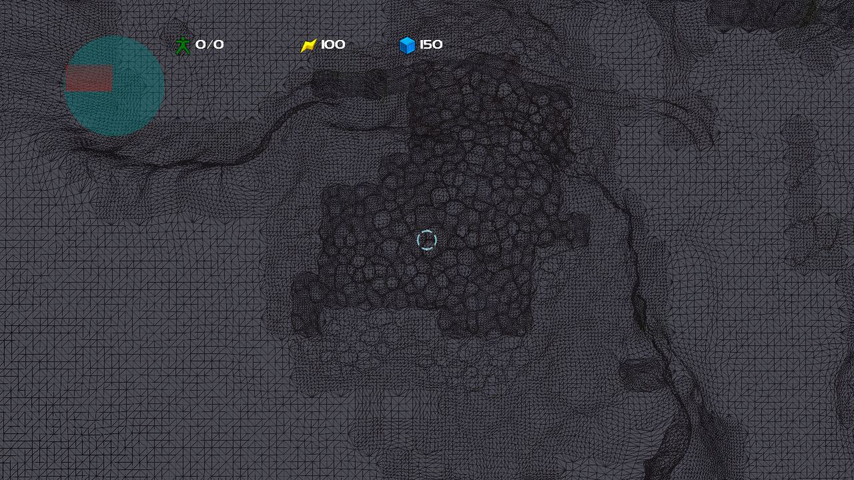

Slide 30
Target Problems
Introduced some new problems
Memory increase
Performance issues
Sim interaction issues
Runtime texturing issues

Slide 31
Problem Sim interaction
New terrain was too difficult for the sim to use
GPU specific & compressed
Vector field ray cast?
Opted to create a lower-resolution version
Height field only
Acted just like older terrain for legacy systems

Slide 32
VisRep™ and SimRep™ split
Solution was to create a CPU side terrain
Called ‘SimRep’
Much lower resolution than VisRep
Which is the GPU side version..
Data organization optimized for height field ray cast & physics

Slide 33
Generating the SimRep™
Render VisRep from top-down on GPU @ the resolution of the SimRep
Also render any meshes flagged for insertion
Read it back on the CPU and sample it
Hole filling & data massaging algorithms
~4 separate versions
Sim, flight, camera, Scarab.
All at different densities

Slide 34
Mesh insertion
Non-terrain playable areas needed
Bridges, Forerunner objects etc.
Artists / Designers can flag meshes in the editor to be ‘included’ in the SimRep
Objects modify SimRep w/o modifying visuals

Slide 35
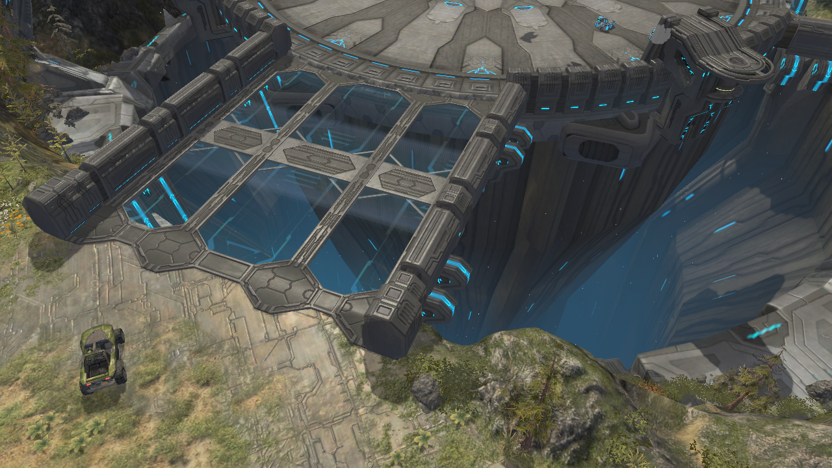

Slide 36
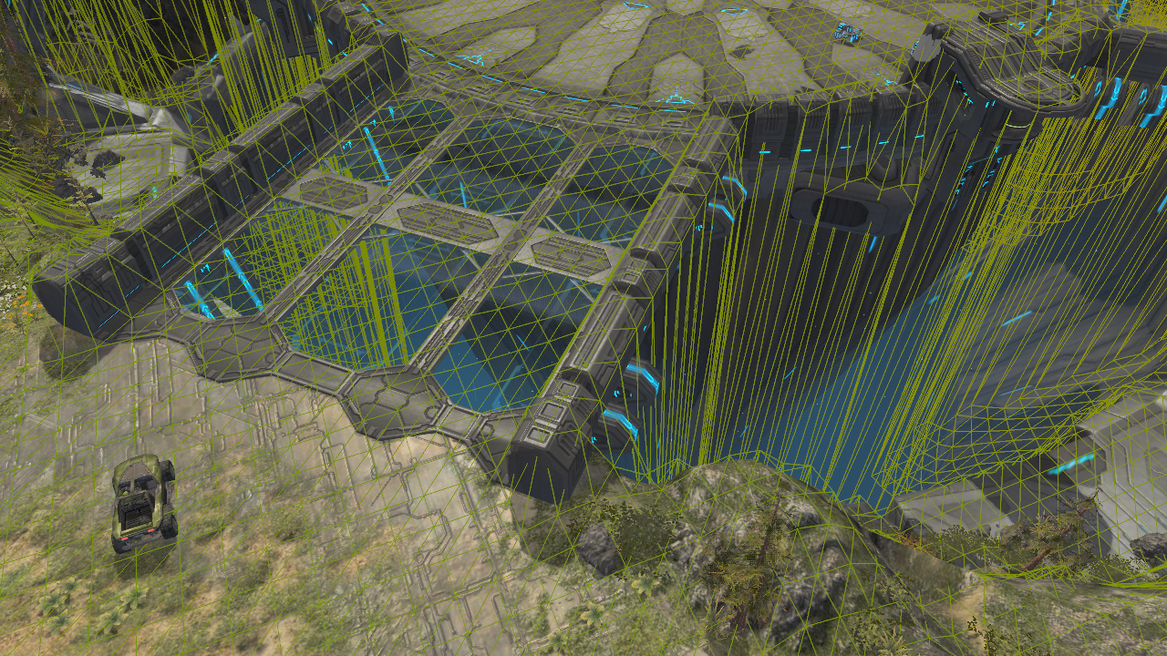

Slide 37
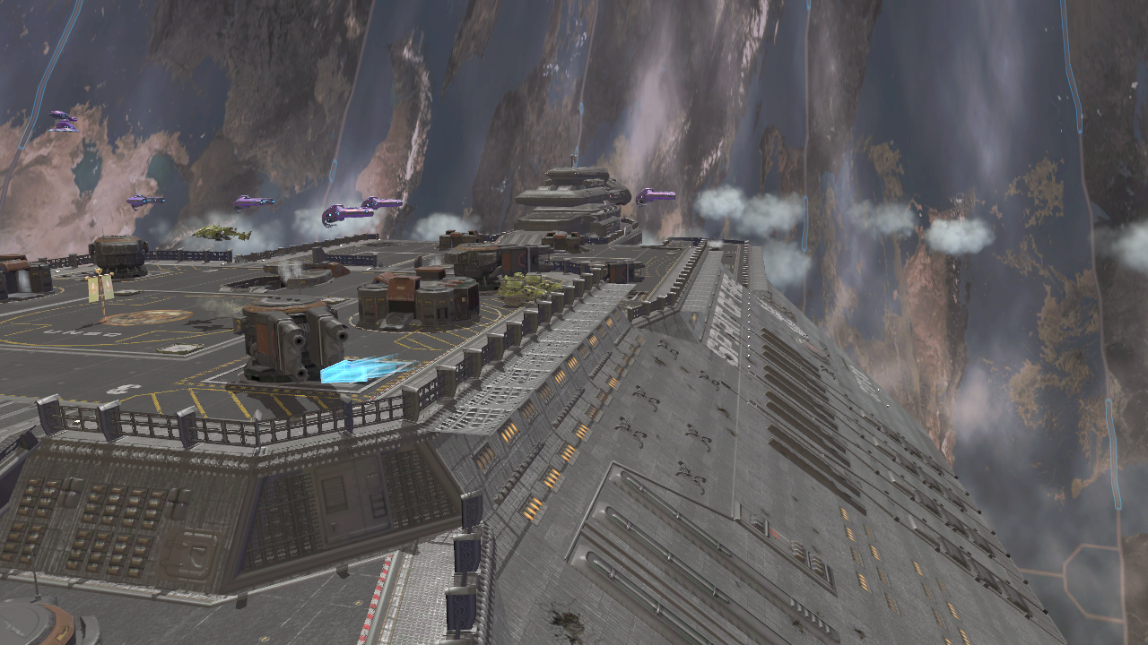

Slide 38
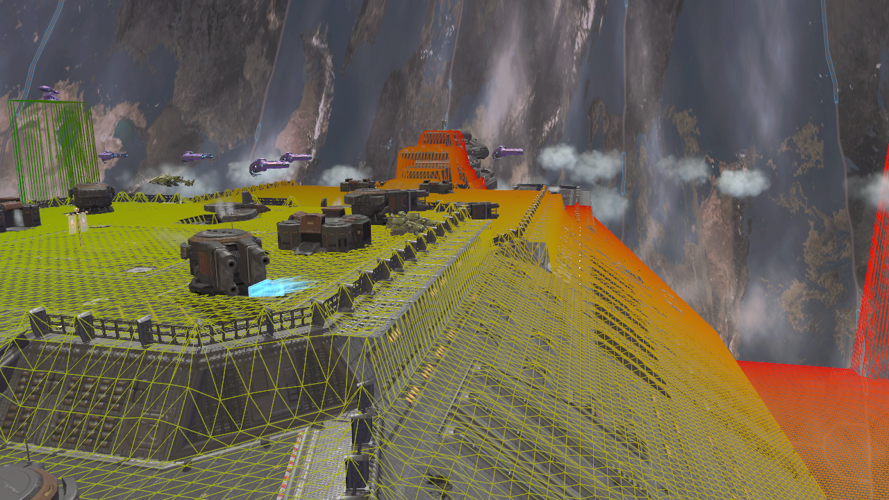

Slide 39
Target Problems
Introduced some new problems
Memory increase
Performance issues
Sim interaction issues
Runtime texturing issues

Slide 40
Problem - Texturing
Increase in density removed ability to do standard ‘splatting’ terrain texturing
Vertex density made GPU choke.
Texture ‘layers’ too complex for multi-blend
Allowed up to 12 texture blends per pixel
Allowed 5 texture channels
Diffuse, Normal, Specular, Emissive, Reflective

Slide 41
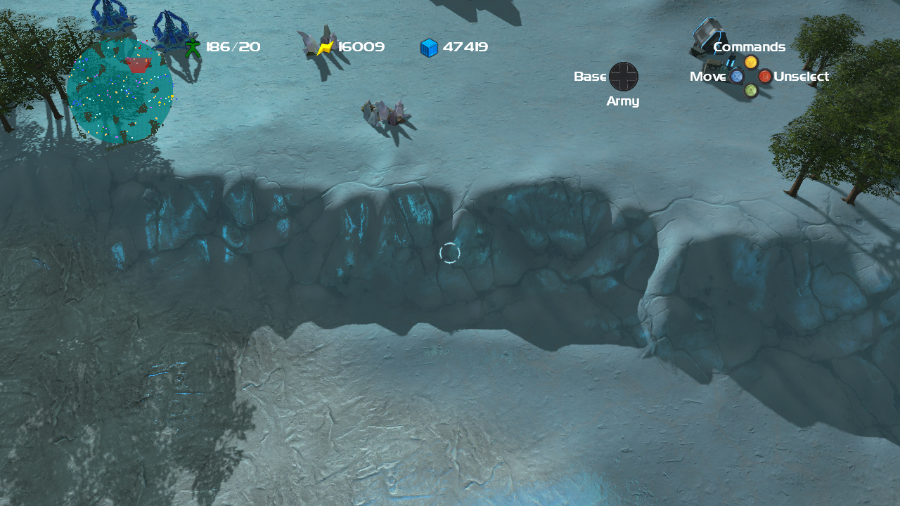

Slide 42
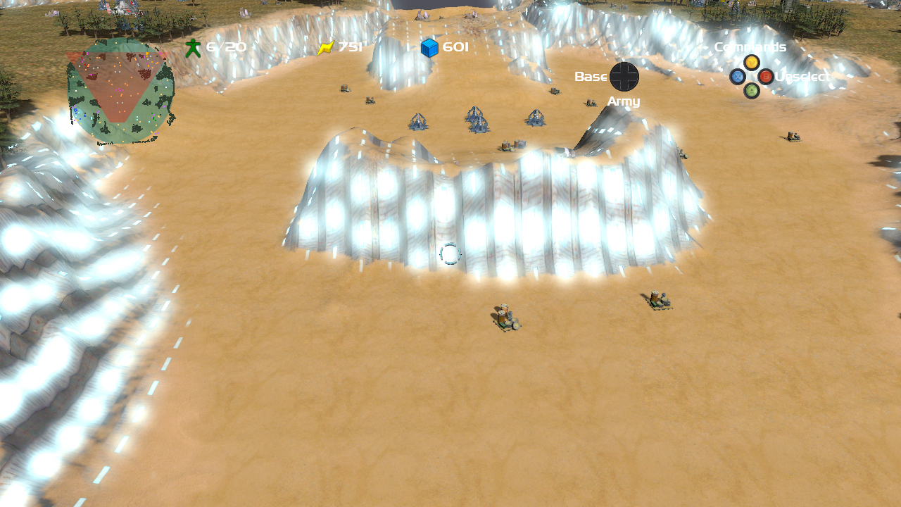

Slide 43
Problem : Texturing
512x512 textures per terrain chunk
Results in 10k x 10k texture across entire terrain
Easier to view texturing as a Virtual Texture
Rather than other types of terrain texturing
Memory footprint too large for ‘unique’ texturing
Decompression speed not fast enough for completely unique textures per chunk

Slide 44
Virtual Textures Pages
Texture pages composited in 2D using splatting
Each texture channel was composited on the GPU
Composited pages placed in a cache
Pages compressed on the fly, on the GPU to fit into memory
Each texture channel had it’s own cache
If a channel didn’t exist on the map, we didn’t allocate

Slide 45
Texture Cache
Custom cache management
One memory allocation @ dawn of time
Used XGSetTextureHeader to point to areas in the allocated memory
“Efficient Cache Replacement Using the Age and Cost metrics” Game Programming Gems 7

Slide 46
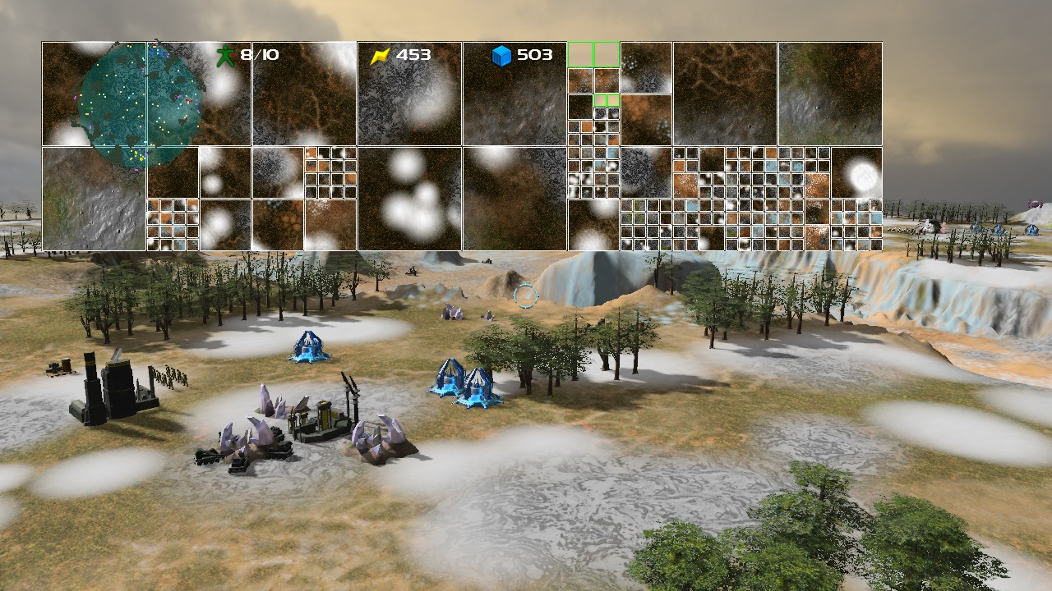

Slide 47
Composinator 8000
After compositing on the GPU, texture is compressed on the GPU
GPU cache sizes (mb):
Diffuse, Spec (RGB), Reflect(RGB) = 3.125 (DXT1)
Each, not cumulative.
Normal = 6.250 (DXTN)
Emissive (sRGB)= 6.250 (DXT5)

Slide 48
Target Problems
Introduced some new problems
Memory increase
Performance issues
Sim interaction issues
Runtime texturing issues
One other thing:

Slide 49
Problem Terrain as an island
Wanted to fix ‘floating in space’ look of RTS
Didn’t have much extra memory footprint
Needed to be really fast
Needed to look convincing for FPS views
Couldn’t increase content creation burden

Slide 50
Terrain Skirt
Decided to mirror playable area across map boundaries
Introduced quad nodes that mirrored their respective geometry in the playable area
Used precomputed cache texture for texturing
Used lowest LOD patches

Slide 51
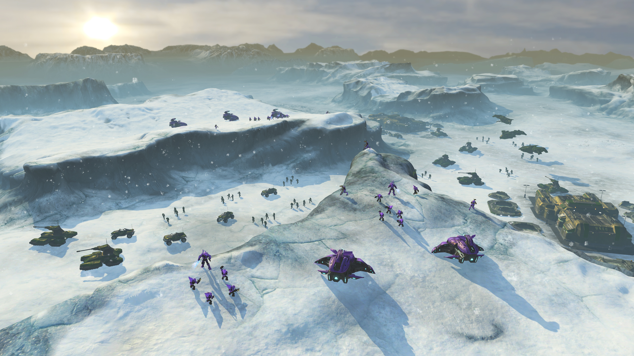

Slide 52
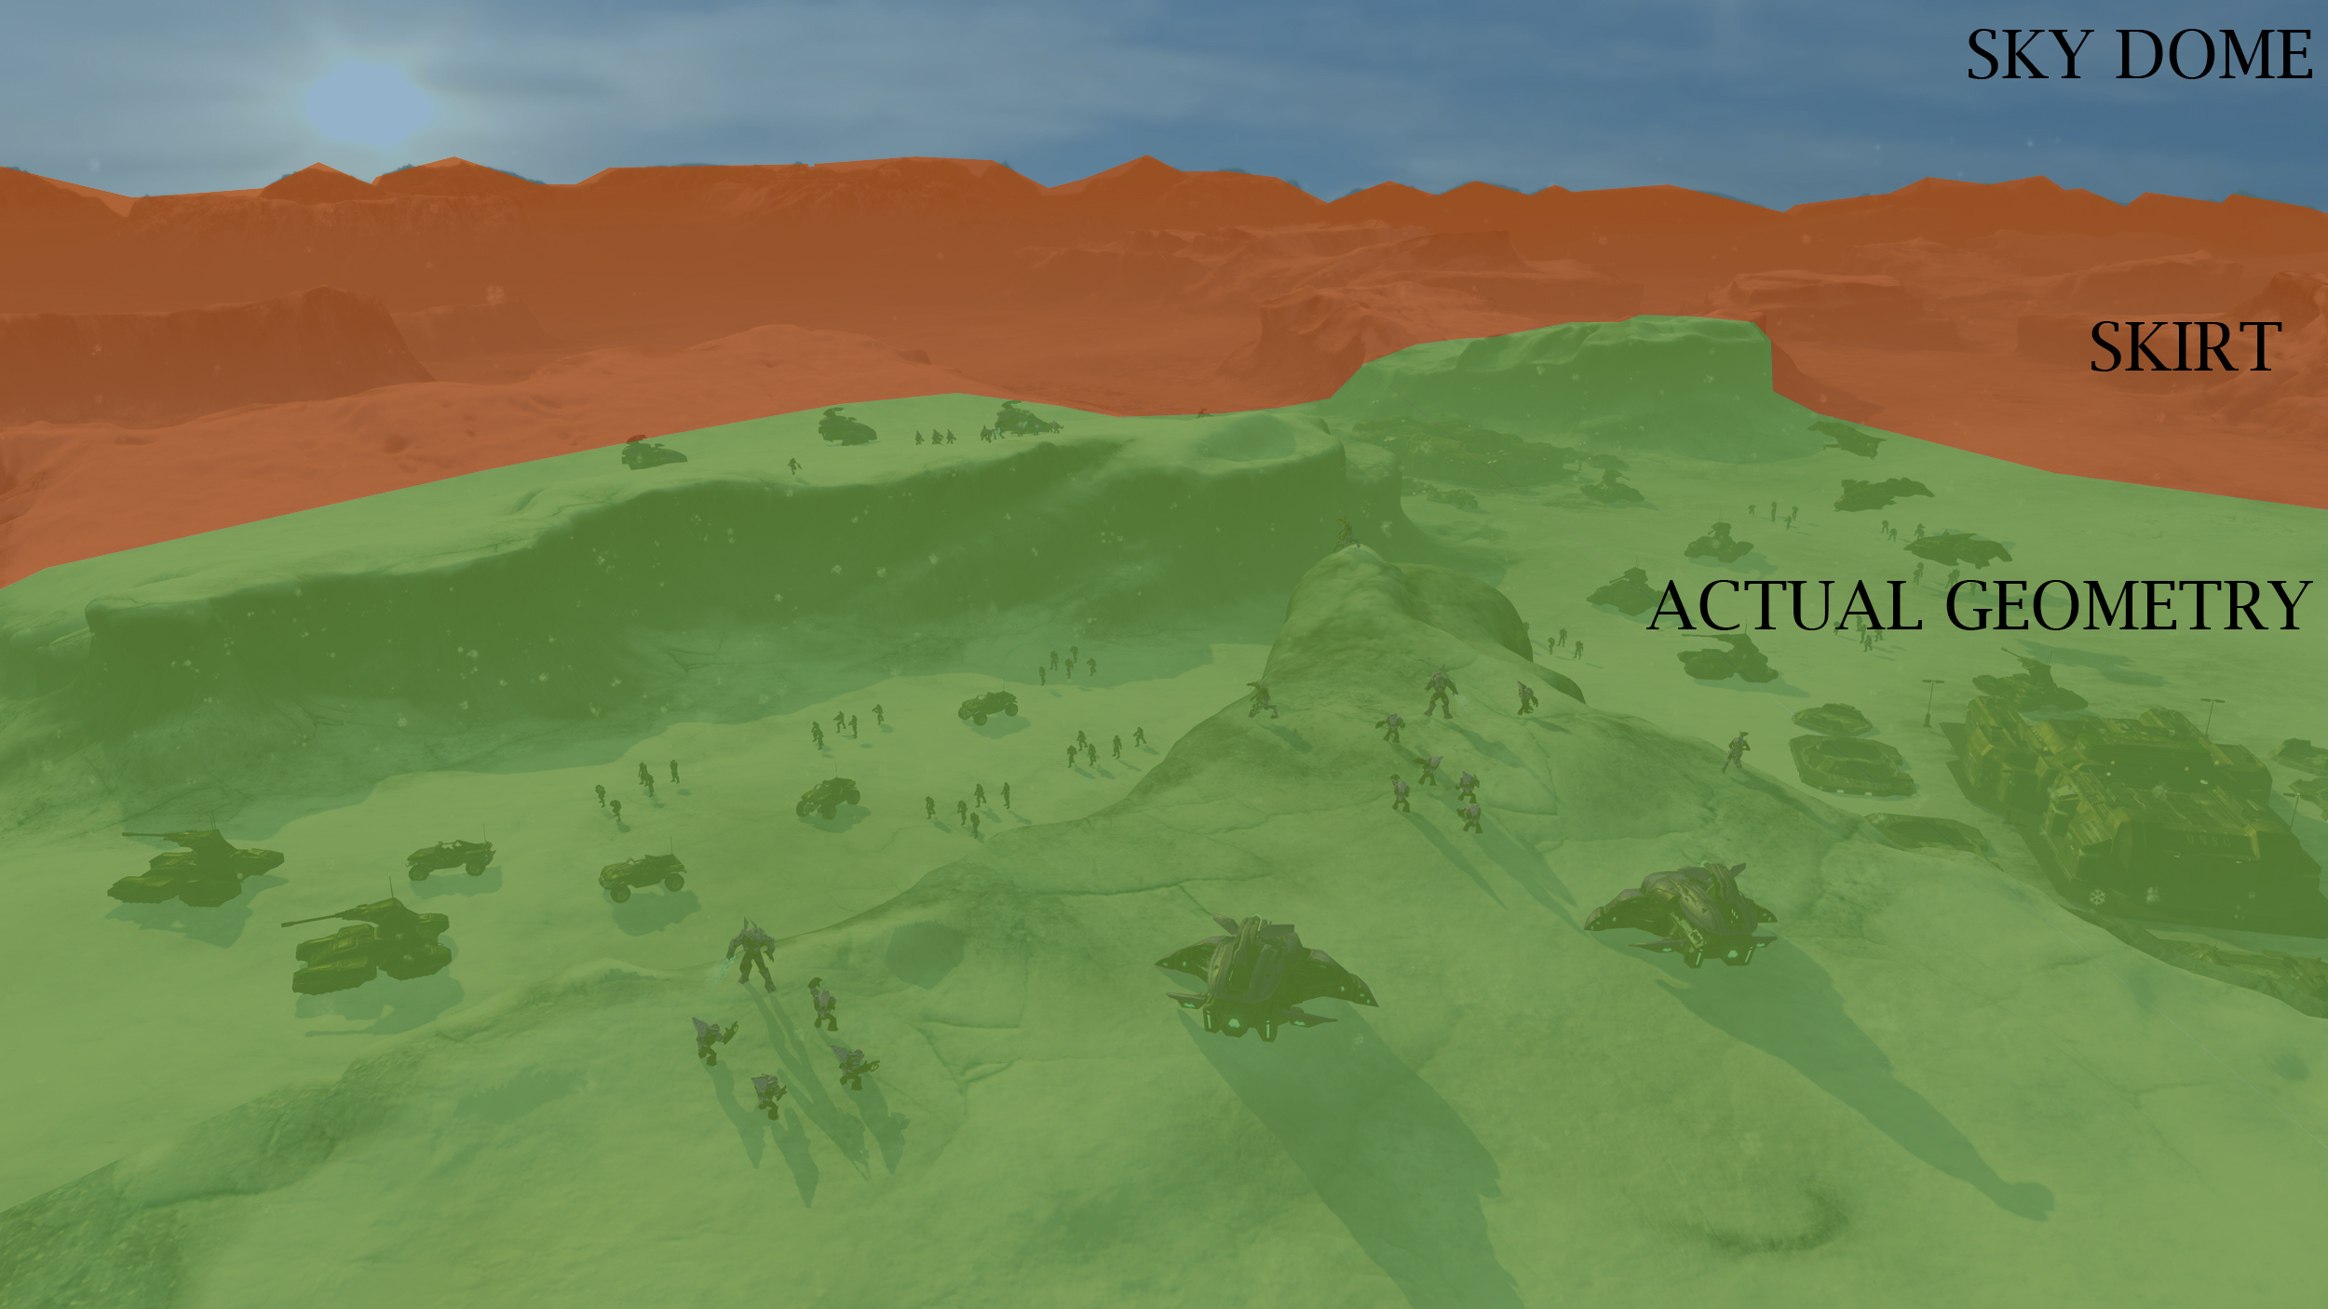

Slide 53
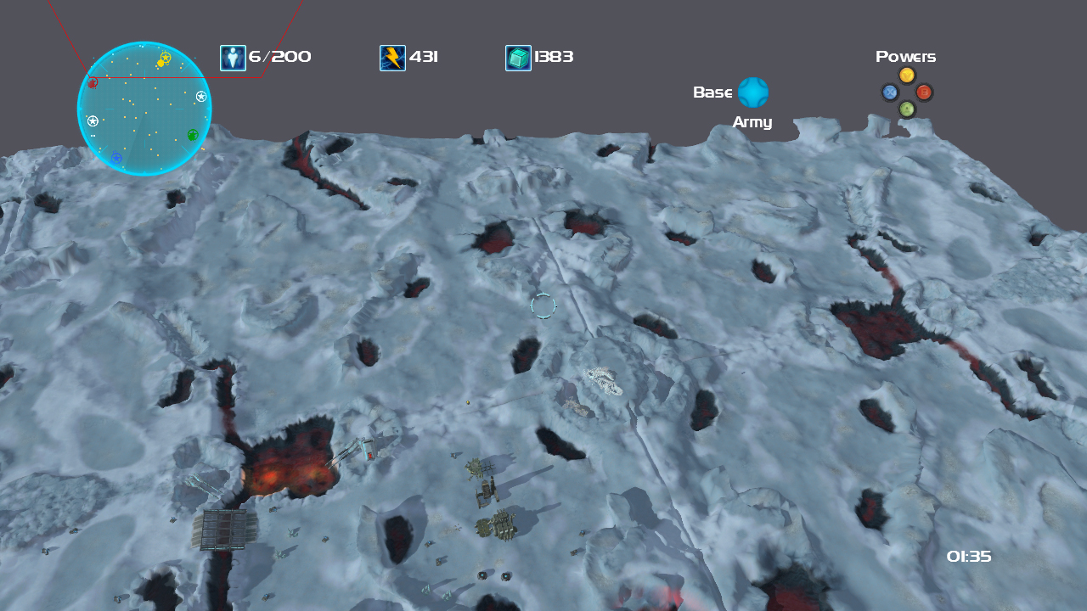

Slide 54
Take Away points
Height field is no longer de-facto
Vector field at it’s basic form is easy to implement
Hardware tessellation is future of terrain
Patch system is perfect fit.
Separation of VisRep and SimRep is great
Allows art and programming departments to make decisions that don’t step on each other's feet.

Slide 55
More Take Away
Increased density is a double edged sword
Make sure you invest in a good decimation technology
Innovation takes more than one solution
Have to attack a multi-headed beast

Slide 56
Who is BONFIRE studios?
New Studio coming out of the closure of Ensemble
Approx. 35 employees
All former ES
Rolling right off of Halo Wars
Currently working on new IP
www.bonfire-studios.com

Slide 57
THANK YOU!!
Contributors
Andrew Foster, Rich Geldreich
Sergio Tacconi, Scott Winsett
coltm@bonfire-studios.com
www.bonfire-studios.com for more slides and videos

Slide 58
EXTRA SLIDES

Slide 59
Problem Editing Terrain
Editor on PC, Game on 360
Needed a robust streaming & reload pipeline
Editor written in C#
You should do this for your tools.
Rendering pipelines duplicated
Written using Managed DirectX
This sucks and no one should ever do it.

Slide 60
Vertex Editing
Density increase forced editor to resemble systems like MUDBOX, ZBRUSH
Full XYZ displacement needed very similar tools
Selection system allowed mass editing
Also allowed introduction of widgets similar to 3DSM and other packages.

Slide 62
Filters & Erosion
Added Filter set to help with terrain features
Standard filters:
fBm, Perlin, Smoothing, plateau
Standard noise filters weren’t enough
Needed more realistic generation of terrain

Slide 63
Hydraulic Erosion
Terrain visuals 100% created by erosion
Added Hydraulic Erosion system
Trace millions of rain drops through the terrain, and move dirt with them
Allow masking system to define used / unused areas
Allow erosion to effect masking for texturing
Multi-threaded for speed
On average, erosion took ~2-3 seconds for a whole map.

Slide 64
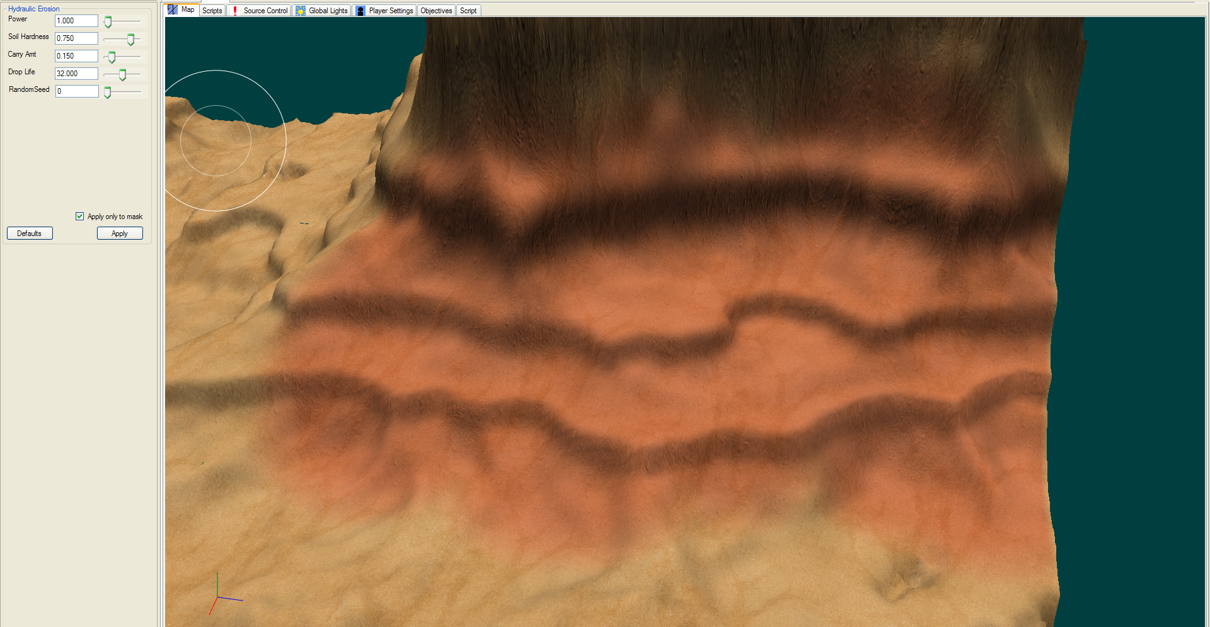

Slide 65
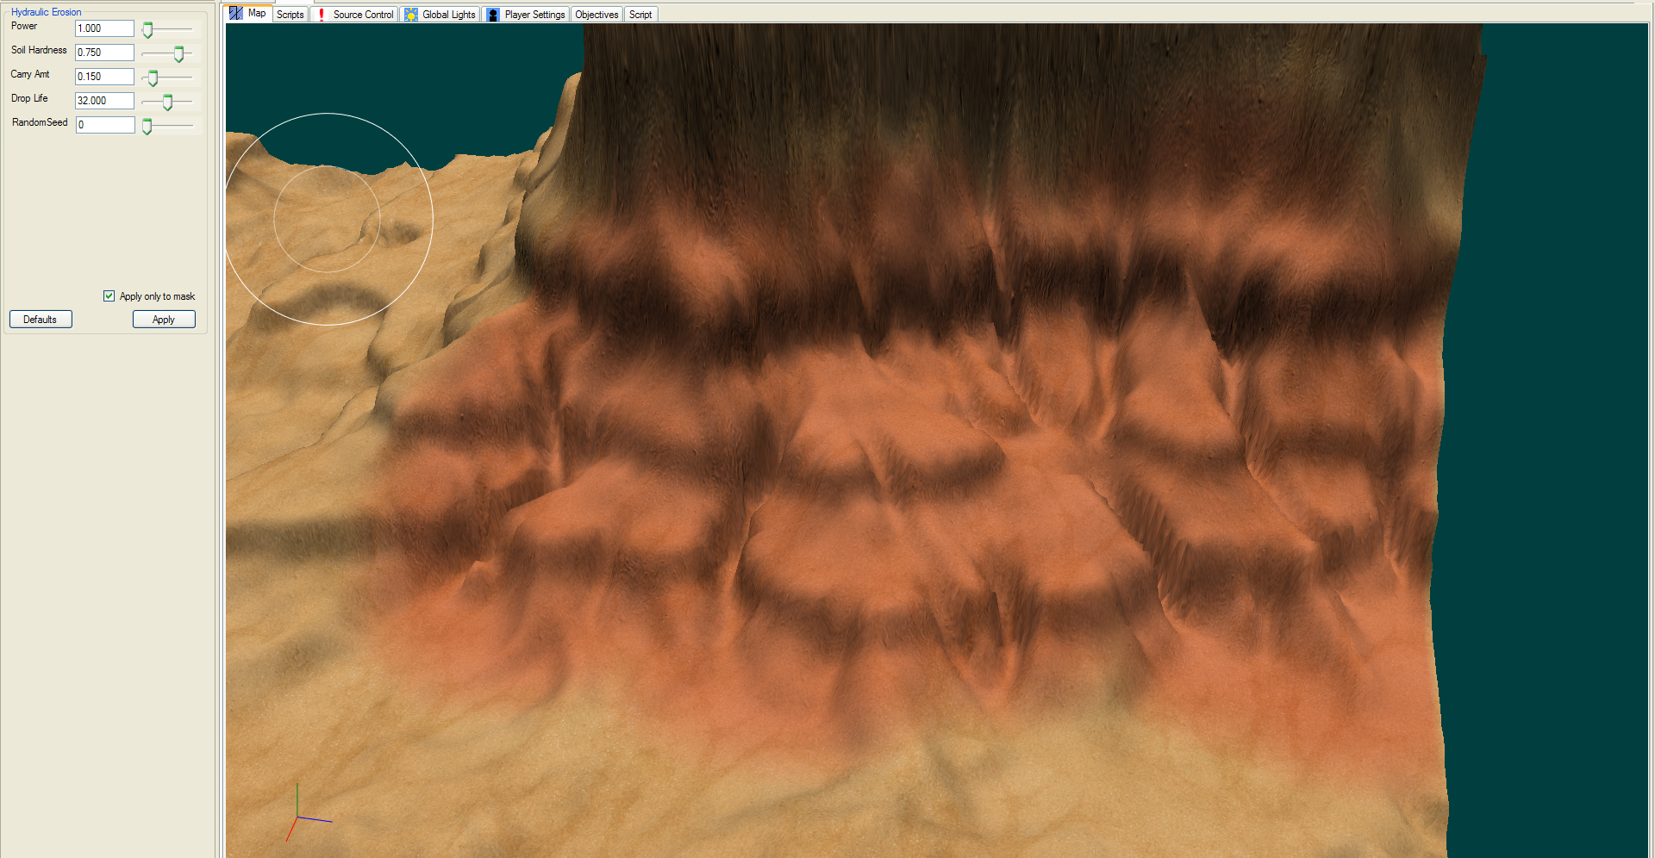

Slide 66
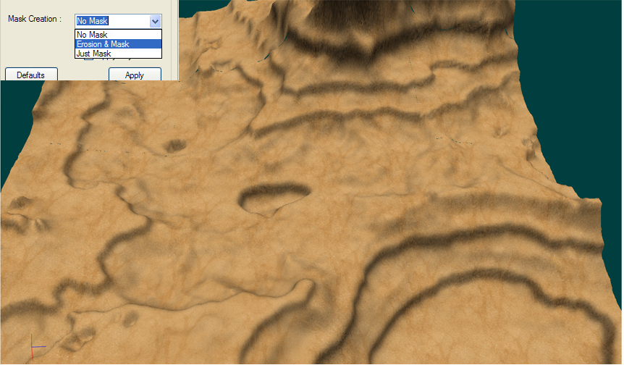

Slide 67
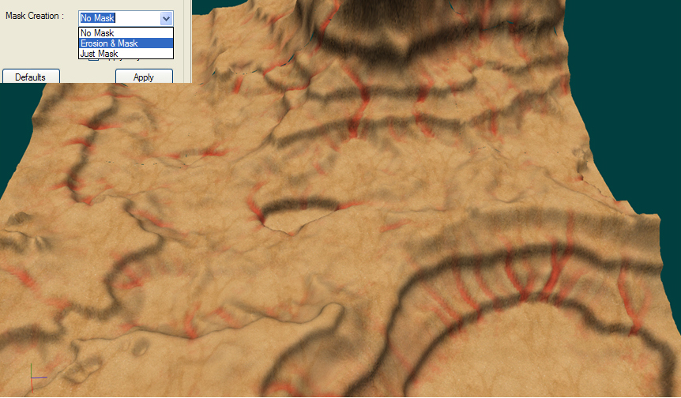

Slide 68
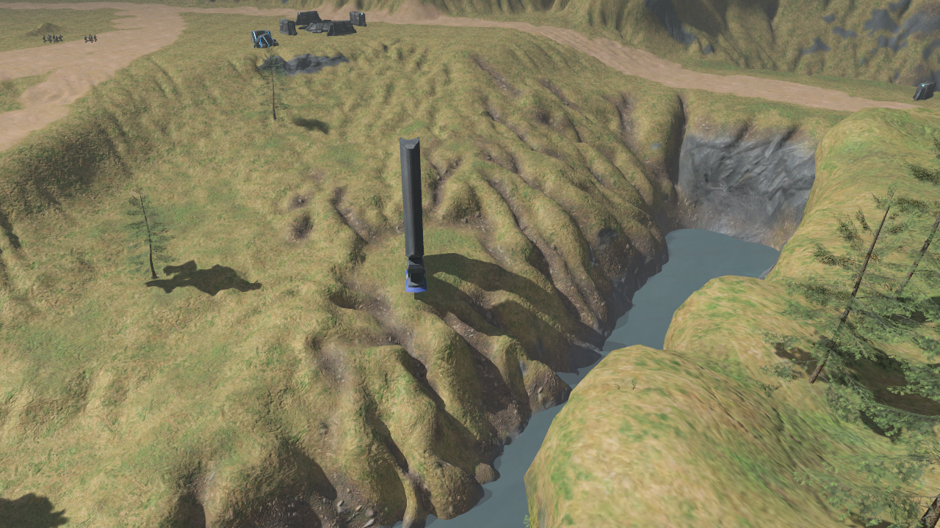

Slide 69
Texture Editing
Requests by artists early on:
Increased alpha resolution
Layers concept
Masking
Extra channels
Masking and layers forced texture editing to mimic Photoshop
Allowed texture-swapping

Slide 70
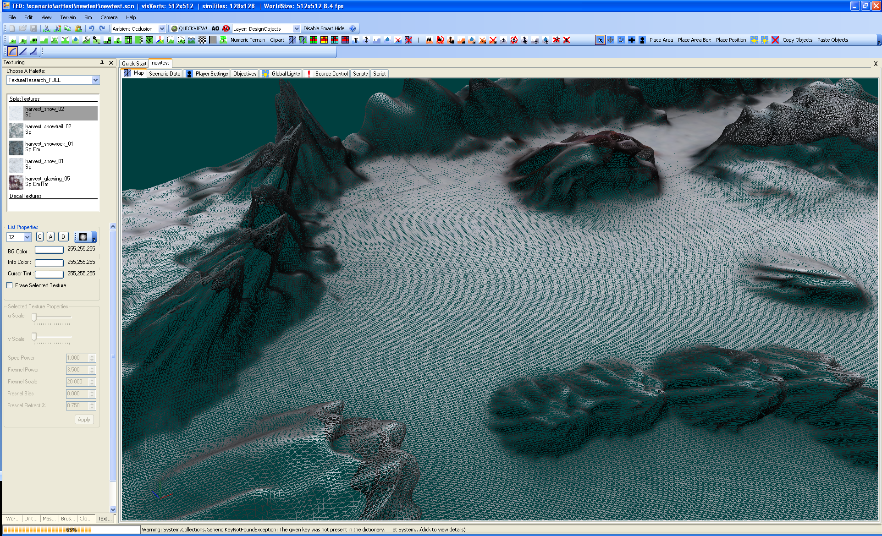
DEMO?

